Slide 1
PIZZA SALES REPORT AND KPI ANALYSIS
USING MYSQL AND POWERBI

Slide 2
CONTENTS
Introduction
Data Overview
Key Metrics
Sales Performance Analysis
Trends & Insights
Dashboard Overview
Conclusions & Recommendations
Appendix

Slide 3
INTRODUCTION
This report presents a comprehensive analysis of pizza sales performance, derived from transactional data collected through a MySQL database and visualized using an interactive Power BI dashboard. The primary objective of this project is to evaluate business performance by identifying key revenue drivers, tracking order volumes, and understanding customer purchasing patterns.
The dataset encompasses detailed order-level information, including pizza types, categories, sizes, quantities, prices, and order dates. By leveraging MySQL for efficient data extraction and Power BI for dynamic visualization, the analysis delivers actionable insights into overall sales performance, product trends, and seasonal variations.

Slide 4
DATA OVERVIEW
The dataset used for this analysis contains detailed transactional records of pizza sales over a defined period. Each entry represents an individual pizza item sold and includes key attributes such as:
Order Details – Unique order ID, order date, and order time.
Product Information – Pizza name, category (Classic, Supreme, Veggie, etc.), size (S, M, L, XL, XXL), and a list of ingredients.
Sales Metrics – Quantity sold, unit price, and total price per item.
In total, the dataset comprises 49,574 pizzas sold across 21,350 unique orders, generating a total revenue of $817,860.05. The sales data spans various product categories and size options, enabling a granular breakdown of performance.

Slide 5
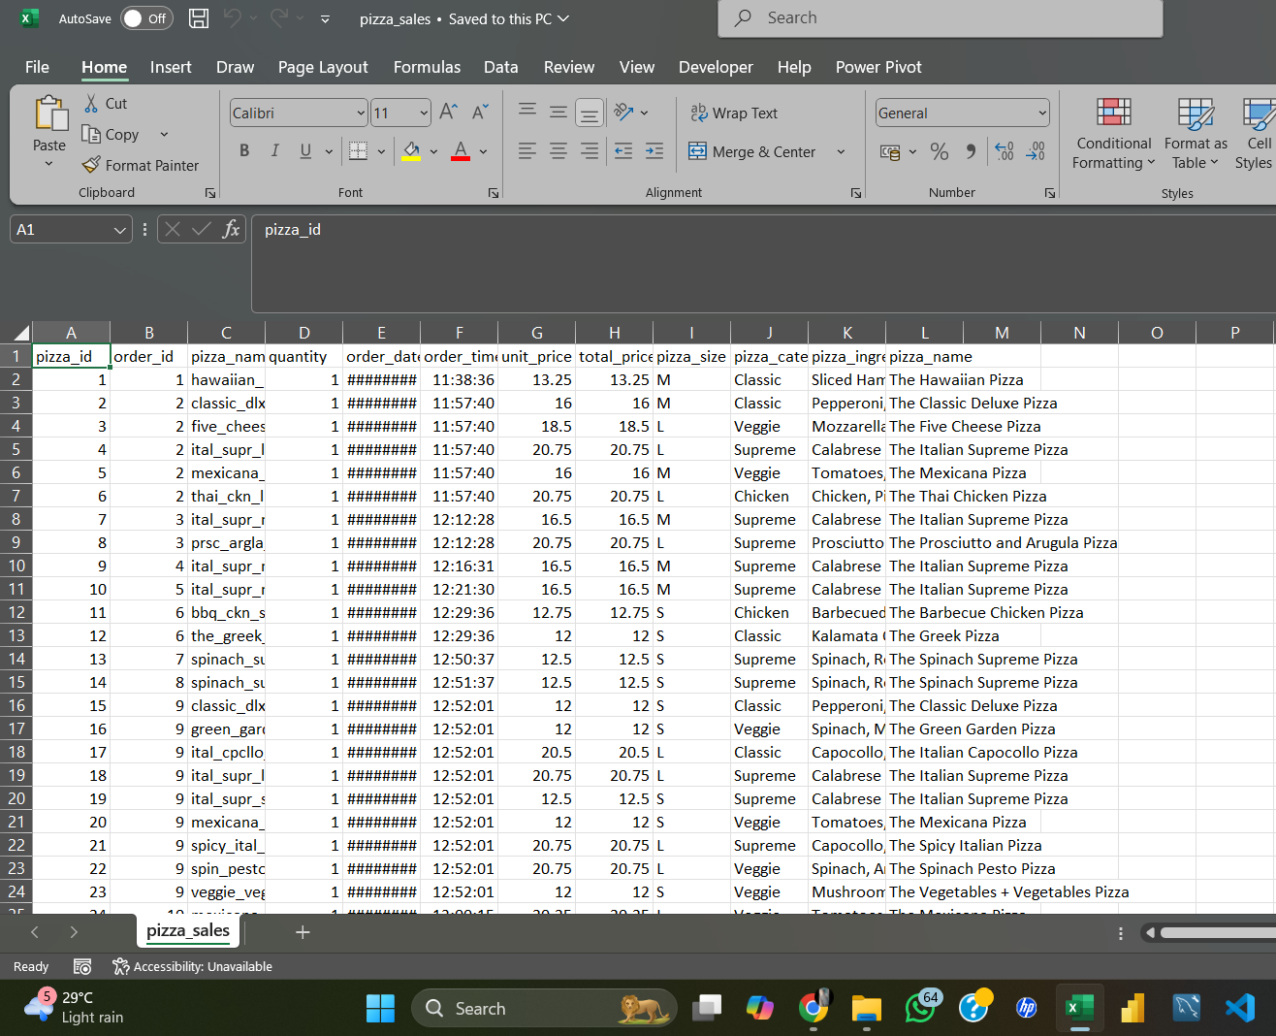
PIZZA DATA (.csv)

Slide 6
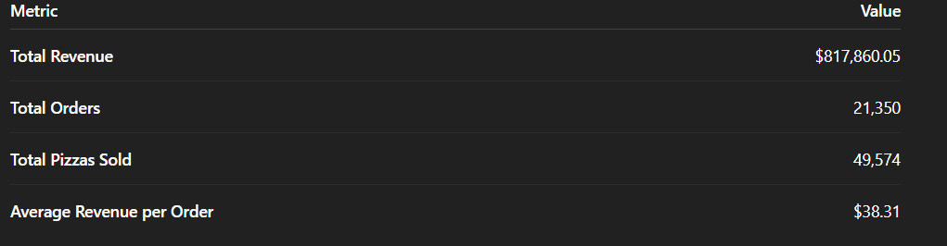
KEY METRICS
The core business performance indicators derived from the dataset are as follows:

Slide 7
SALES PERFORMANCE ANALYSIS
category-wise Sales Performance
Classic Pizzas accounted for the largest share of sales, contributing significantly to both revenue and volume.
Supreme and Veggie pizzas maintained steady sales, while Chicken pizzas showed strong revenue per order despite lower volume.
5.2 Size-wise Sales Performance
Large (L) pizzas dominated sales volume, reflecting customer preference for value in portion size.
Medium (M) pizzas contributed significantly to total orders, often chosen for single or smaller group orders.
Extra-Large (XL) and Double Extra-Large (XXL), while lower in volume, generated higher revenue per unit.
5.3 Top & Bottom Performing Pizzas
Top performers included The Classic Deluxe Pizza and The Five Cheese Pizza, which consistently ranked high in both quantity and revenue.
Bottom performers were niche items with limited appeal, indicating potential candidates for menu optimization.

Slide 8
TRENDS AND INSIGHTS
Daily & Monthly Revenue Trends
Revenue peaks were observed during weekends, suggesting higher dining activity during leisure periods.
Certain months showed above-average revenue, possibly linked to promotions or seasonal demand.
6.2 Seasonal & Weekday Patterns
Fridays and Saturdays recorded the highest sales volumes.
December and January showed elevated sales, aligning with festive and holiday seasons.

Slide 9
DASHBOARD OVERVIEW
The interactive Power BI dashboard built for this project provides:
Real-time filtering by date range, category, size, and pizza name.
Dynamic visuals for revenue, order count, and product performance.
Comparative charts for category-wise and size-wise distribution.
Drill-through capability to view order-level details.
This dashboard allows stakeholders to quickly identify trends, monitor KPIs, and make data-driven decisions without manually analyzing raw data.

Slide 10
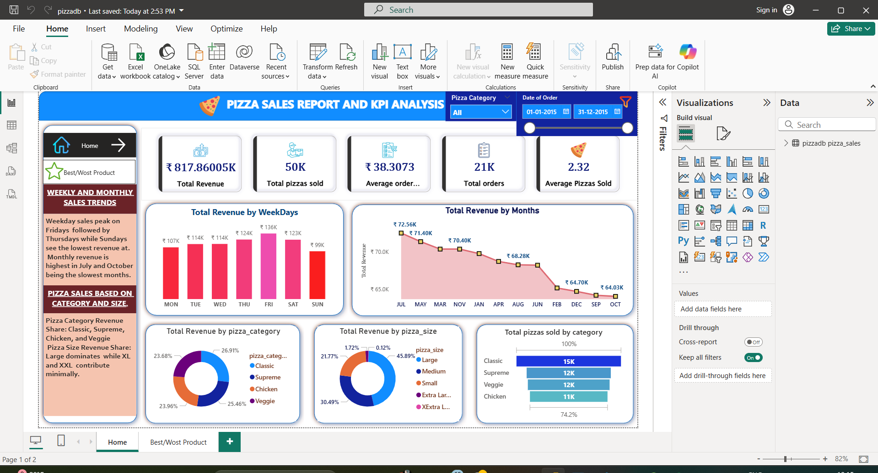

Slide 11
CONCLUSIONS AND RECOMMENDATION
Conclusions
Sales are driven by a strong preference for large-sized pizzas and the Classic category.
Weekends and holiday periods contribute disproportionately to revenue.
A small subset of pizzas drives the majority of sales, while several products underperform.
Recommendations
Menu Optimization – Retain top sellers and review low-performing items for potential removal or rebranding.
Targeted Promotions – Focus marketing campaigns on weekdays to boost mid-week sales.
Upselling Strategies – Encourage upgrades from medium to large sizes, leveraging customer size preferences.
Seasonal Offers – Capitalize on high-demand festive months with special bundles or discounts.

Slide 12
APPENDIX
SQL Queries Used
Queries for extracting total revenue, total orders, and top/bottom performers.
Joins and aggregations to calculate category and size distributions.
9.2 Additional Charts & Graphs
Category-wise revenue share pie chart.
Size-wise sales bar chart.
Monthly revenue trend line chart.

